Slide 1
Document Q&A Studio
A RAG-Powered Document Intelligence System
Shlok Pikle | B01036267

Slide 2
Introduction
Document Q&A Studio is an intelligent document analysis system that leverages Retrieval-Augmented Generation (RAG) technology to enable natural language querying of PDF documents.
Key Features:
• Upload and process PDF documents with automatic text extraction
• Intelligent semantic search using vector embeddings
• Natural language question-answering powered by GPT-4
• Interactive web interface with PDF viewer and chat panel
• Context-aware responses with source page references

Slide 3
Implementation Details - Architecture
System Architecture:
1. Document Processing Pipeline
  • PDF upload and text extraction using PyPDF2
  • Text chunking with RecursiveCharacterTextSplitter (1000 chars, 200 overlap)
  • Page boundary preservation for source tracking
2. Vector Storage & Retrieval
  • OpenAI text-embedding-3-small (1536 dimensions)
  • Qdrant vector database with cosine similarity
  • Metadata storage (page numbers, doc IDs, timestamps)

Slide 4
Implementation Details - Backend
Backend Implementation:
• FastAPI REST API with async endpoints
• CORS middleware for frontend integration
• Three main endpoints:
  - POST /upload: Process and index PDF documents
  - POST /query: Natural language question answering
  - GET /documents/{doc_id}.pdf: Serve original PDFs
• RAG Pipeline:
  - Query embedding → Vector search (top-k=5)
  - Context retrieval → GPT-4o-mini generation
  - Response with source citations

Slide 5
Implementation Details - Frontend
Frontend Implementation:
• Vue.js 3 (CDN-based, no build step required)
• Tailwind CSS for modern, responsive UI
• Two-panel layout:
  - PDF viewer (iframe-based)
  - Interactive Q&A chat panel
• Key Features:
  - Drag-and-drop file upload
  - Real-time query processing
  - Context chips with page navigation
  - Collapsible chat panel for focus

Slide 6
Implementation Details - Docker Deployment
Containerized Architecture:
🐳 Docker Compose Setup
  • Qdrant service: Official Qdrant container on port 6333
  • FastAPI application: Custom Python 3.11 container
  • Service orchestration with automatic dependency management
💾 Data Persistence
  • Named volumes for Qdrant storage (qdrant_storage)
  • Persistent document storage across container restarts
⚙️ Configuration
  • Environment variables for API keys and service URLs
  • Port mapping: 8000 (app), 6333 (Qdrant)
  • Single command deployment: docker-compose up

Slide 7
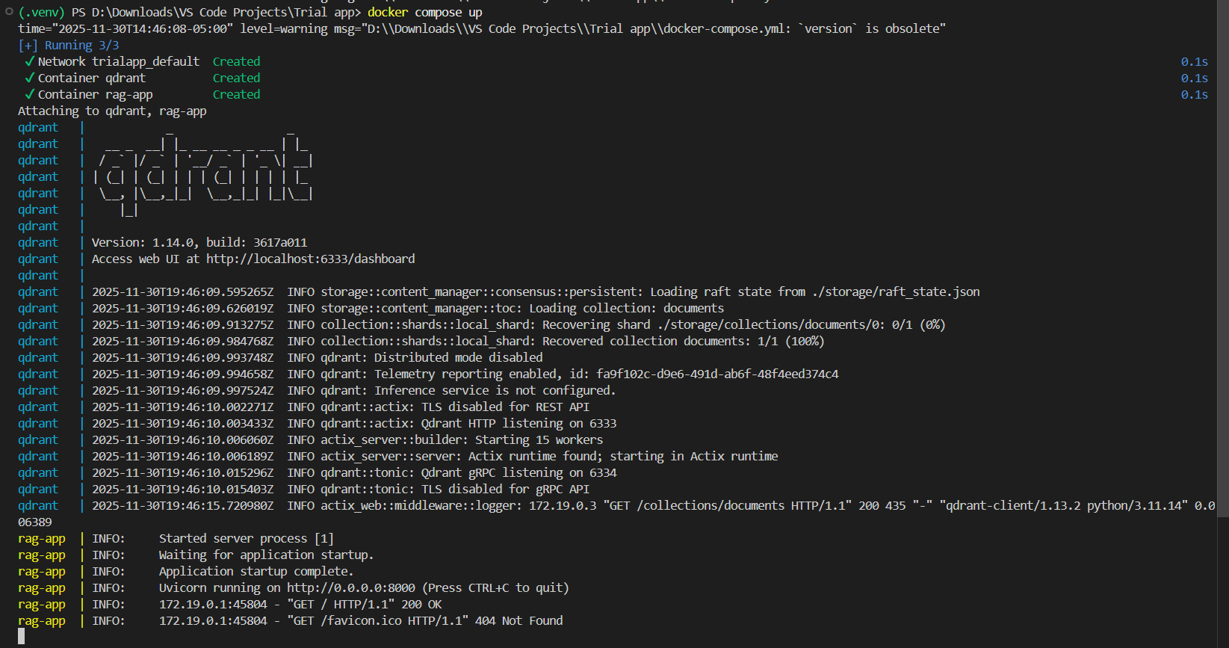
Demo

Slide 8
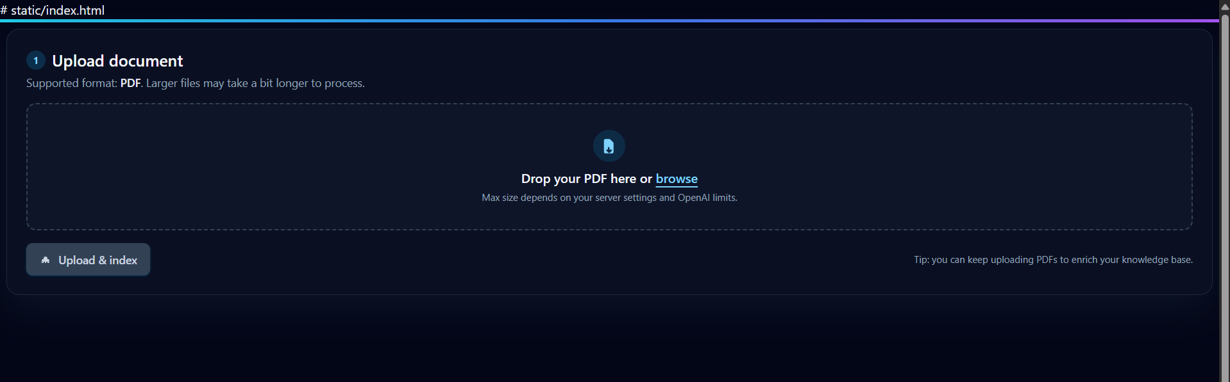
Demo

Slide 9
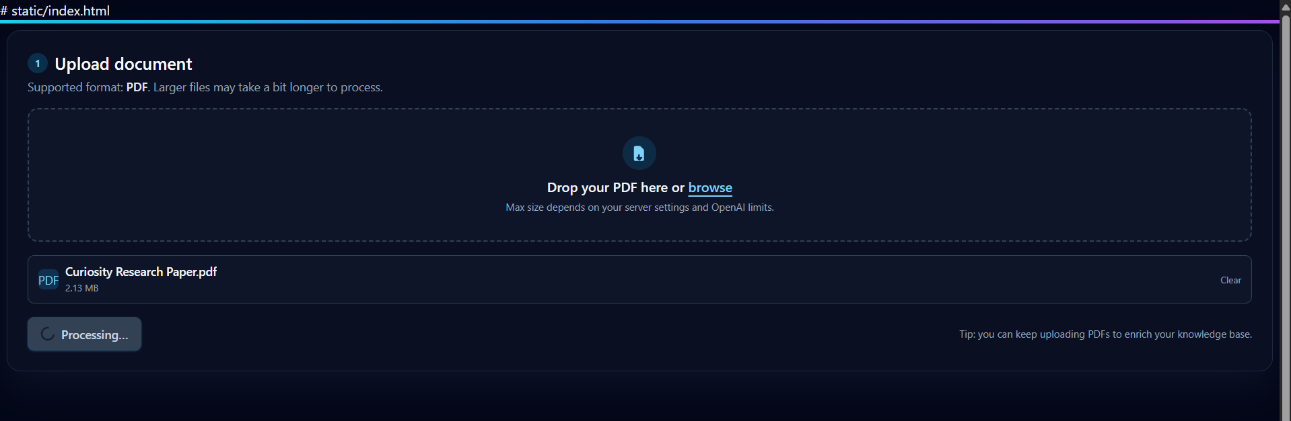
Demo

Slide 10
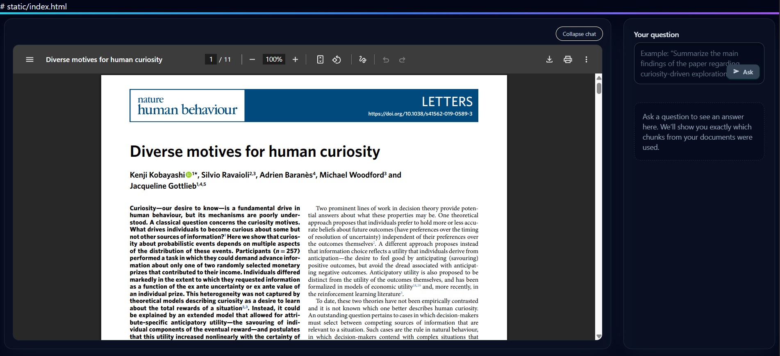
Demo

Slide 11
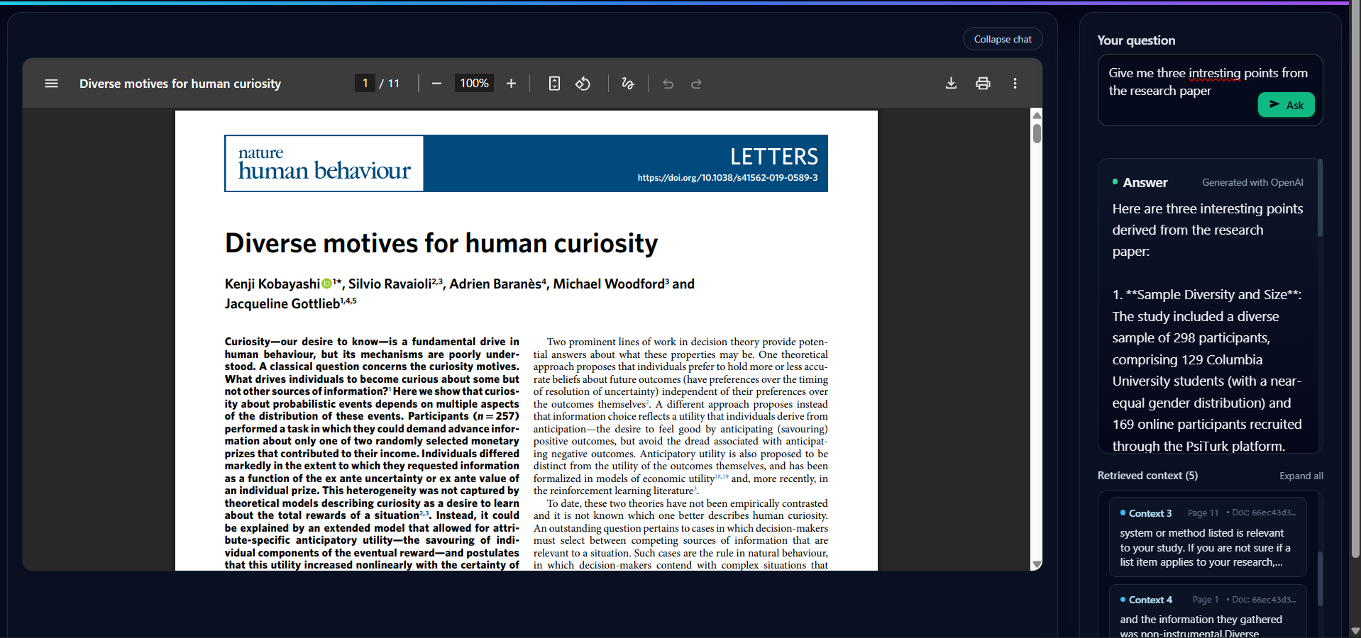
Demo

Slide 12
Use Cases
Document Q&A Studio can be used for:
📄 Research Paper Analysis
  Quickly extract key findings, methodologies, and conclusions from academic papers
📚 Technical Documentation Q&A
  Ask specific questions about API documentation, user manuals, or technical guides
📊 Business Report Analysis
  Extract insights, statistics, and summaries from lengthy business reports
🎓 Educational Content Review
  Students and educators can quickly find answers in textbooks and course materials

Slide 13
Tech Stack
Backend Technologies:
• Python 3.11
• FastAPI - Modern async web framework
• Uvicorn - ASGI server
• PyPDF2 - PDF text extraction
• LangChain - Text splitting utilities
AI & Vector Database:
• OpenAI API - GPT-4o-mini & text-embedding-3-small
• Qdrant - Vector similarity search engine
Frontend Technologies:
• Vue.js 3 - Progressive JavaScript framework
• Tailwind CSS - Utility-first CSS framework
Deployment:
• Docker & Docker Compose - Containerization
• Multi-container setup with Qdrant and FastAPI services
• Persistent volume storage for vector database
• Environment-based configuration for easy deployment

Slide 14
Thank You
Questions?

